Slide 1
Core java day10
NEEHARIKA

Slide 2
Piped streams

Slide 3
Java – Piped Writer
The PipedWriter class is used to write java pipe as a stream of characters. This class is used generally for writing text. Generally PipedWriter is connected to a PipedReader and used by different threads.

Slide 4
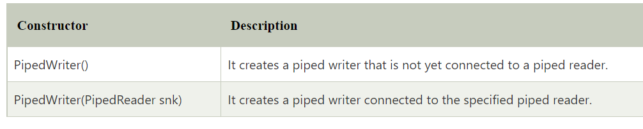
Constructor

Slide 5
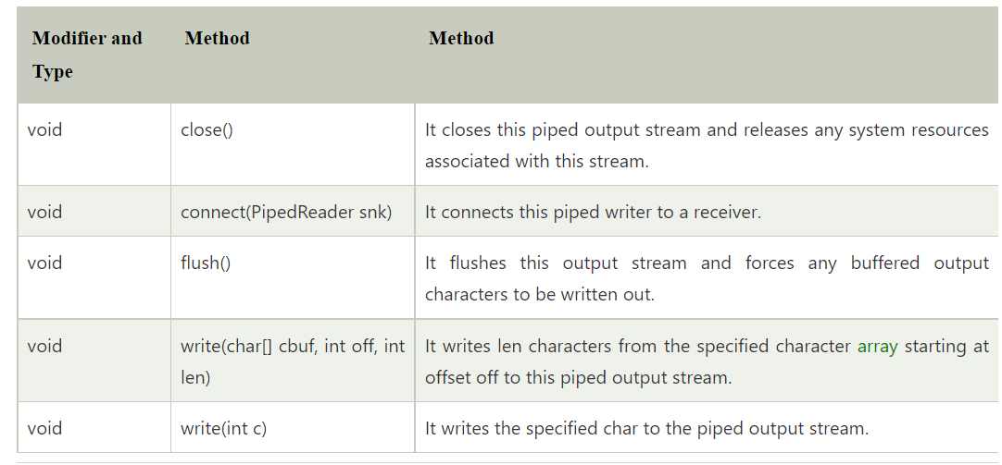
Method

Slide 6
Java – Piped Reader
The PipedReader class is used to read the contents of a pipe as a stream of characters. This class is used generally to read text.
PipedReader class must be connected to the same PipedWriter and are used by different threads

Slide 7
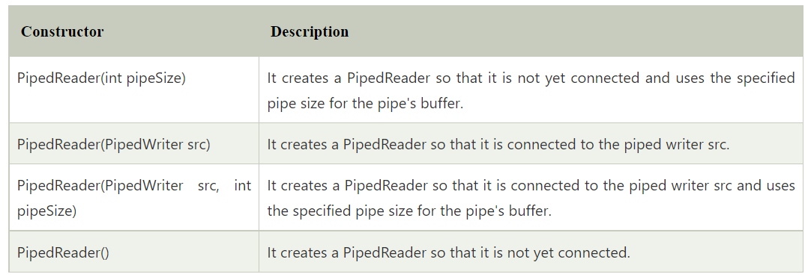
Constructor

Slide 8
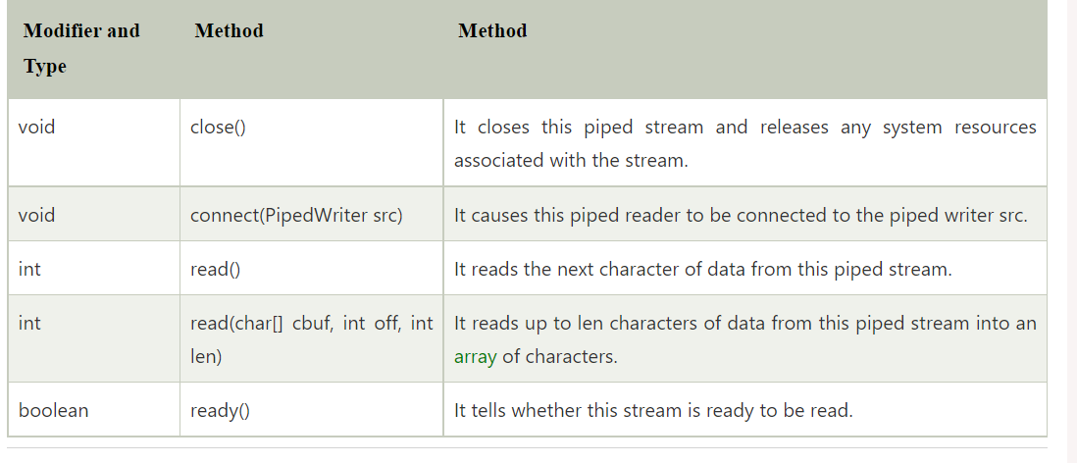
Method

Slide 9
Java Sequence InputStream Class
Java
SequenceInputStream class
is used to read data from multiple streams
. It reads data sequentially (one by one).

Slide 10
Java SequenceInputStream Class declaration
public class SequenceInputStream extends InputStream

Slide 11
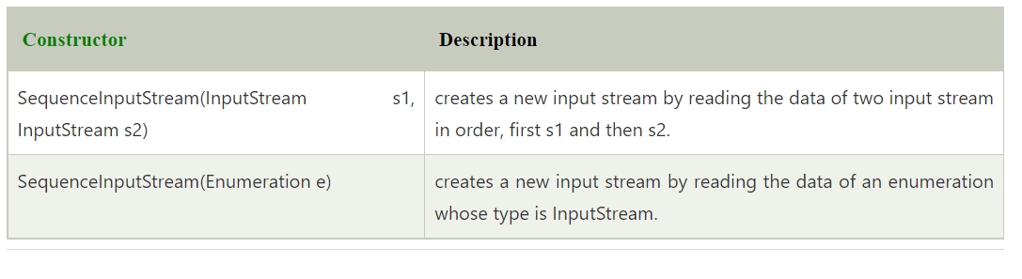
Constructors of Sequence InputStream class

Slide 12
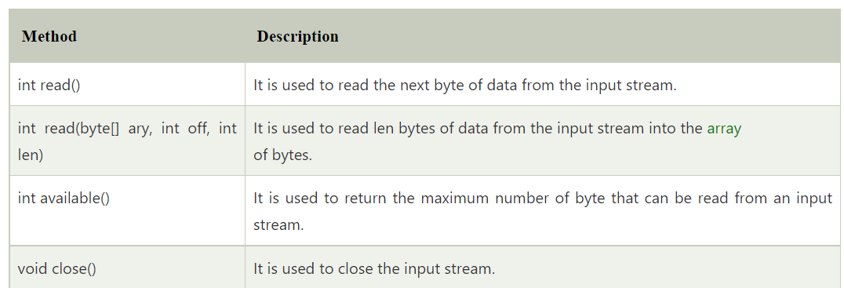
Methods of Sequence InputStream class

Slide 13
Data Types in Java
Data types specify the different sizes and values that can be stored in the variable. There are two types of data types in Java:
Primitive data types: The primitive data types include boolean, char, byte, short, int, long, float and double.
Non-primitive data types: The non-primitive data types include Classes
Interfaces
and Arrays

Slide 14
Java Primitive Data Types
There are 8 types of primitive data types:
boolean data type
byte data type
char data type
short data type
int data type
long data type
float data type
double data type

Slide 15
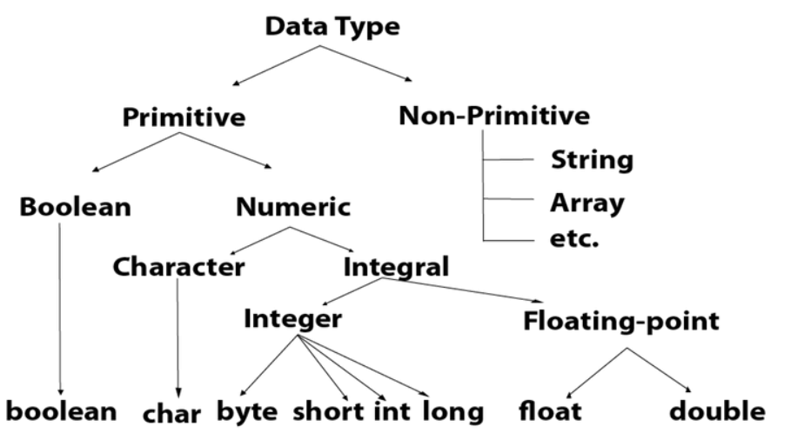

Slide 16
Java – Random Access File
A random access file behaves like a large array of bytes.

Slide 17
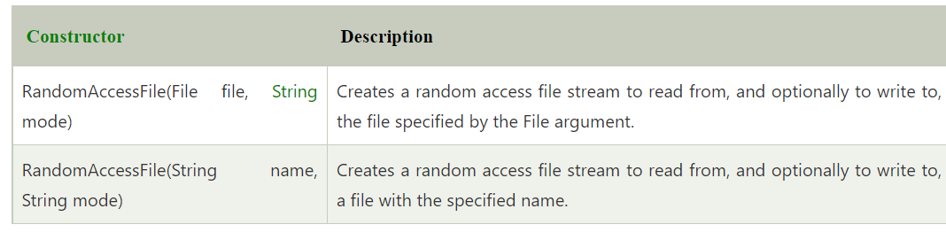
Constructor

Slide 18
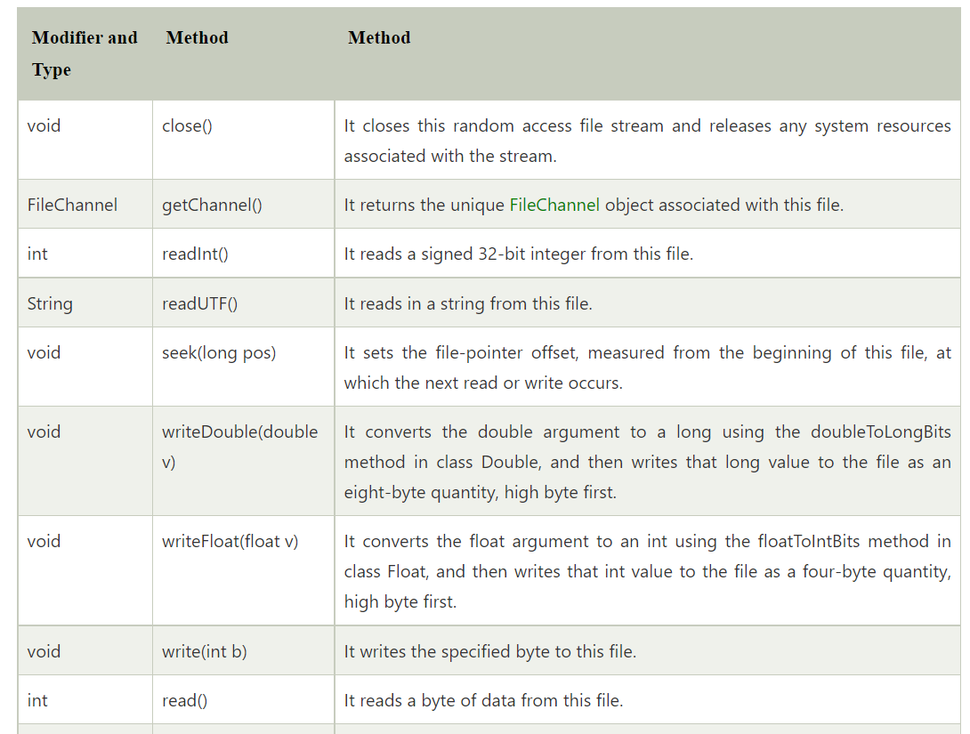
Method

Slide 19
Serialization
Serialization in Java is a mechanism of writing the state of an object into a byte-stream. It is mainly used in Hibernate, RMI, JPA, EJB and JMS technologies.
For serializing the object, we call the writeObject() method of ObjectOutputStream class

Slide 20
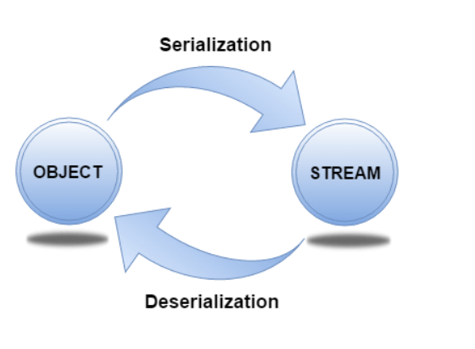
Advantages of Java Serialization

Slide 21
Object OutputStream class
The ObjectOutputStream class is used to write primitive data types, and Java objects to an OutputStream. Only objects that support the java.io.Serializable interface can be written to streams.

Slide 22
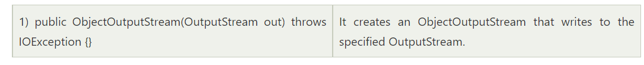
Constructor

Slide 23
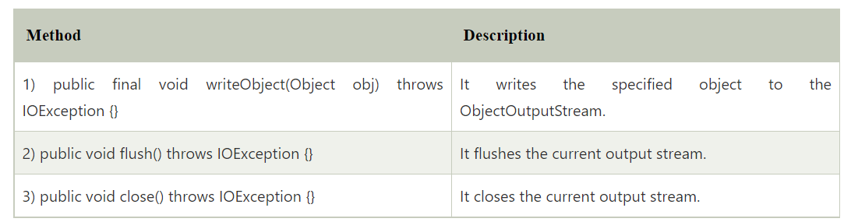
Important Methods

Slide 24
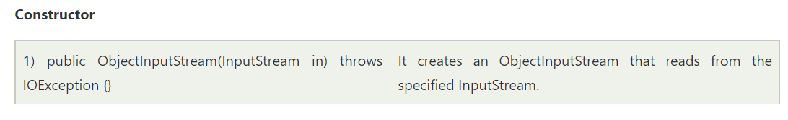
Object InputStream class

Slide 25
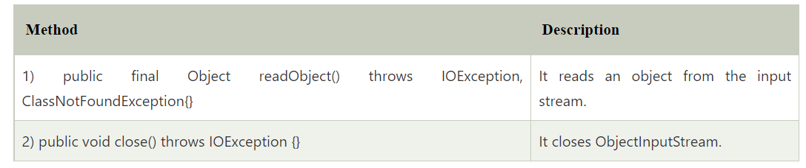

Slide 26
Java Serialization with Inheritance (IS-A Relationship)
Java Serialization with Aggregation (HAS-A Relationship)
Java Serialization with the static data member
Java Serialization with array or collection

Slide 27
Multi tasking
Multitasking term used in a modern computer system. It is a logical extension of a multiprogramming system that enables the execution of multiple programs simultaneously. In an operating system, multitasking allows a user to perform more than one computer task simultaneously. Multiple tasks are also known as processes that share similar processing resources like a CPU. The operating system keeps track of where you are in each of these jobs and allows you to transition between them without losing data.

Slide 28
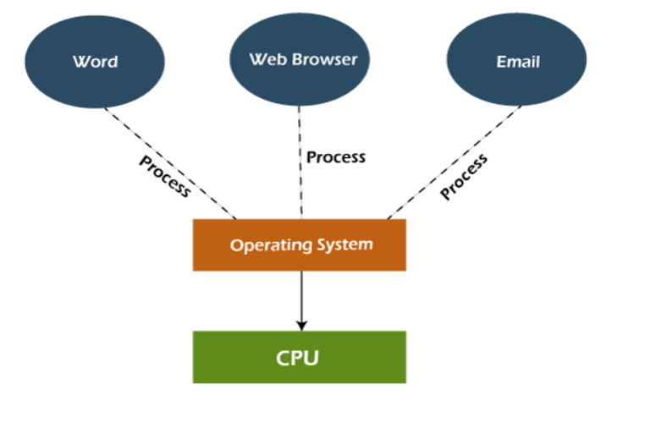

Slide 29
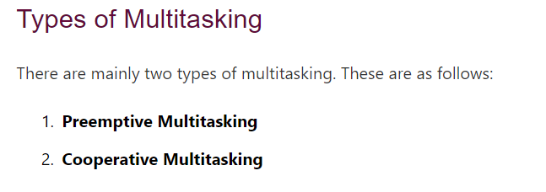

Slide 30
Advantages of Multitasking
Manage Several Users
Virtual Memory
Good Reliability
Secured Memory
Time Shareable
Background Processing
Optimize the computer resources
Use Several Programs

Slide 31
Thread
A Thread is a very light-weighted process, or we can say the smallest part of the process that allows a program to operate more efficiently by running multiple tasks simultaneously.

Slide 32
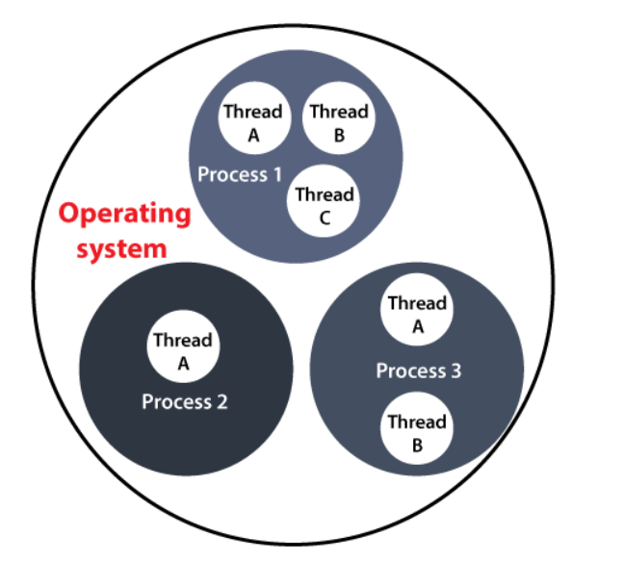

Slide 33
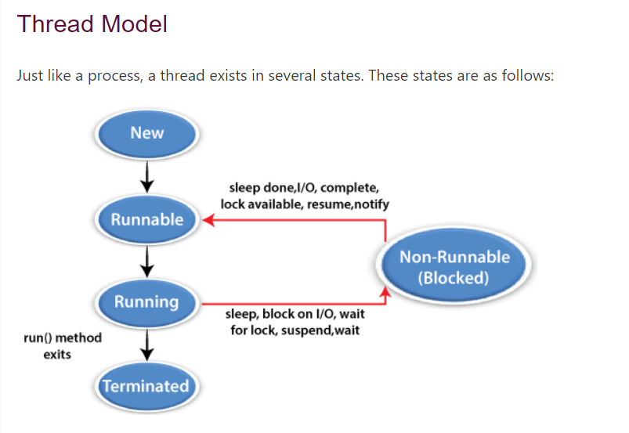

Slide 34
Thread Class
Thread()
Thread(Runnable, String name)
Thread(Runnable target)
Thread(ThreadGroup group, Runnable target, String name)
Thread(ThreadGroup group, Runnable target)
Thread(ThreadGroup group, String name)
Thread(ThreadGroup group, Runnable target, String name, long stackSize)

Slide 35
disAdvantages of Multitasking
Processor Boundation
Memory Boundation
CPU Heat Up

Slide 36
Thread Class
Thread()
Thread(Runnable, String name)
Thread(Runnable target)
Thread(ThreadGroup group, Runnable target, String name)
Thread(ThreadGroup group, Runnable target)
Thread(ThreadGroup group, String name)
Thread(ThreadGroup group, Runnable target, String name, long stackSize)

Slide 37
Runnable Interface(run() method)
The Runnable interface is required to be implemented by that class whose instances are intended to be executed by a thread. The runnable interface gives us the run() method to perform an action for the thread.

Slide 38
start() method
The method is used for starting a thread that we have newly created. It starts a new thread with a new callstack. After executing the start() method, the thread changes the state from New to Runnable. It executes the run() method when the thread gets the correct time to execute it.

Slide 39
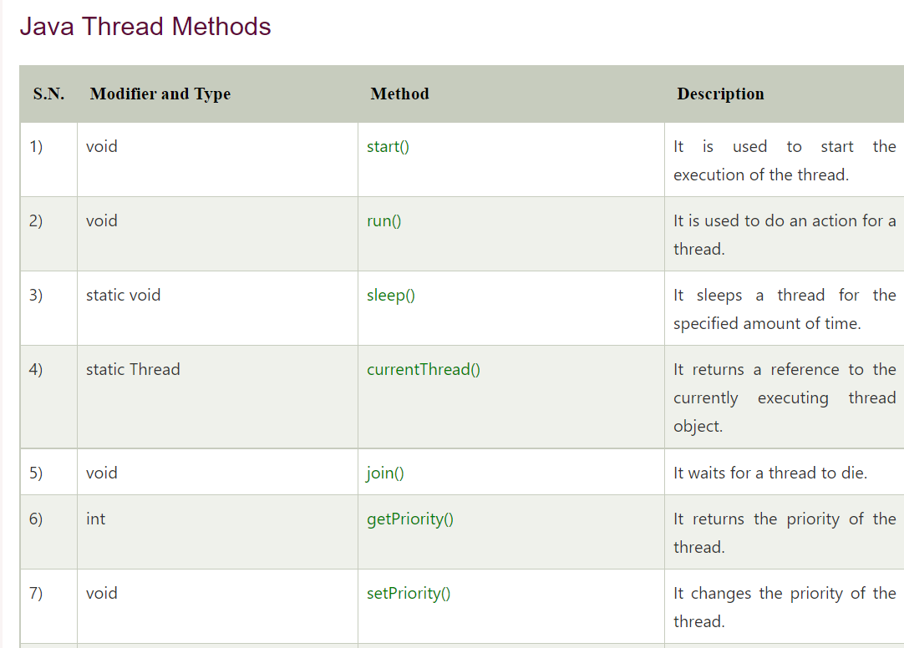

Slide 40
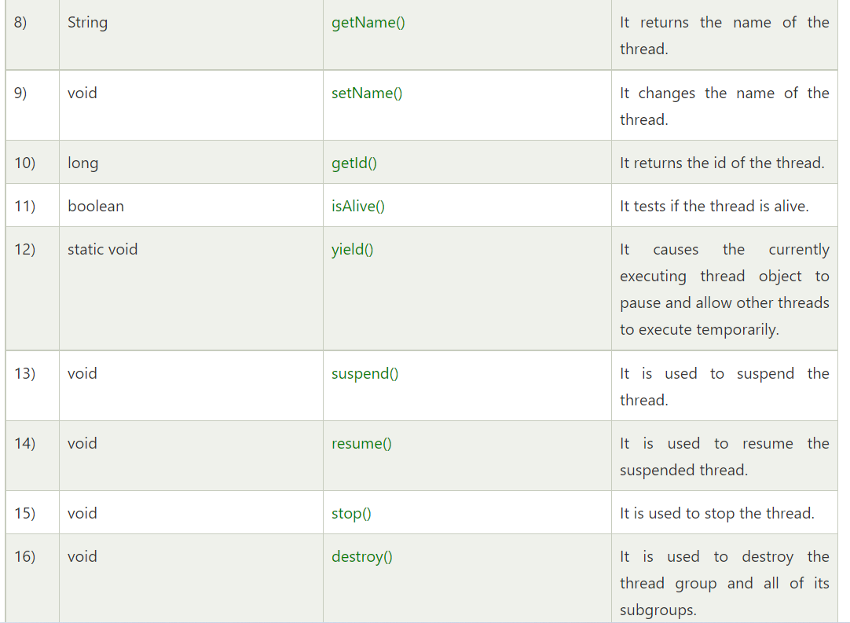

Slide 41
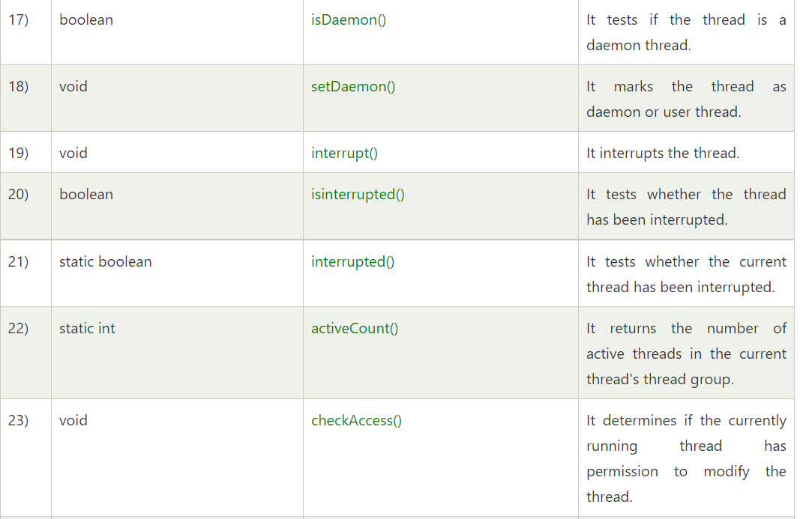

Slide 42
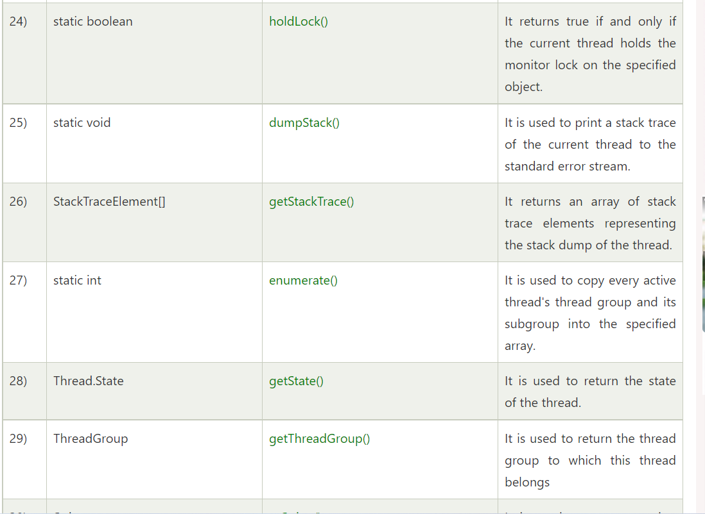

Slide 43
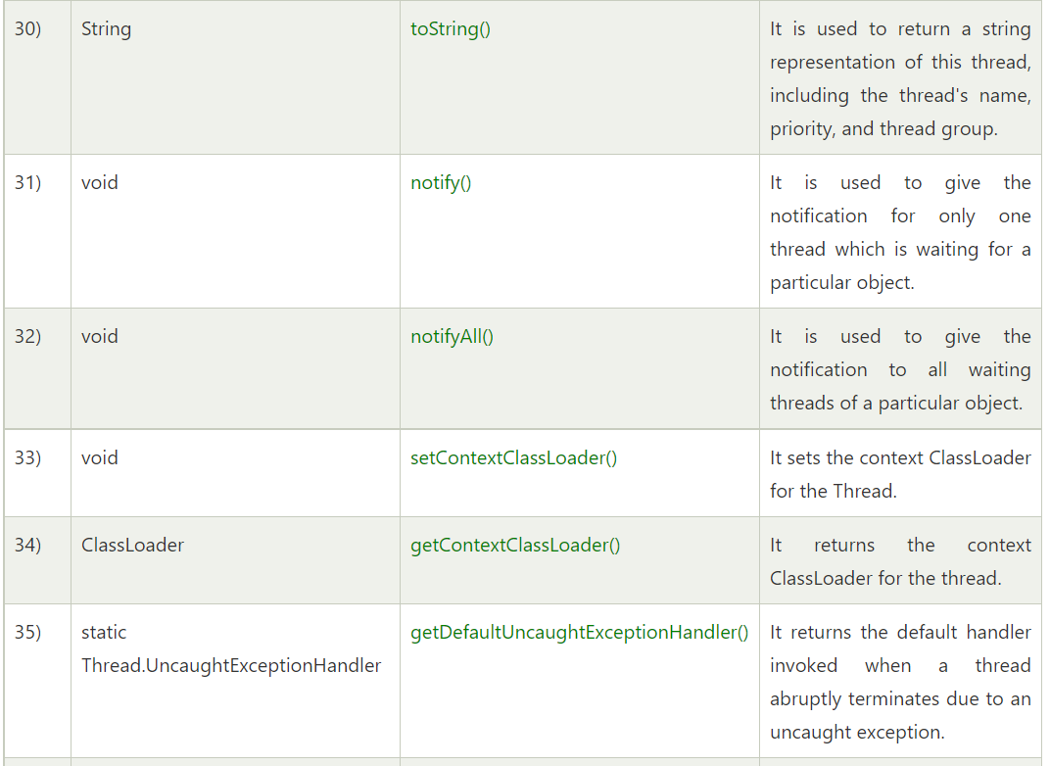

Slide 44
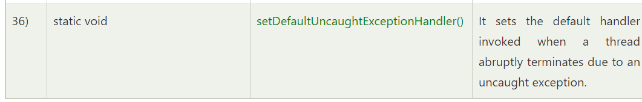

Slide 45
Thank you

